Slide 1
Introduction to Containers
Thomas Juettemann, EMBL-EBI
Notes:
Hello Everyone and welcome. In this segment of the course I will introduce you to container technologies.
First we will have a look for what caused the need for this technology.
Then we explore what a container actually is, how it compares to a virtual machine and finishing with the most common docker commands.

Slide 2

How did we get here?

Slide 3

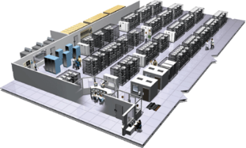
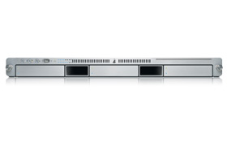

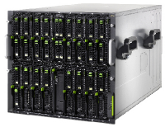

The Challenge
Static website
User DB
Queue
nginx 1.5 + modsecurity + openssl + bootstrap 2
postgresql + pgv8 + v8
HDF5 + kita
Redis +
redis-sentinel
Analytics DB
Do services and apps interact appropriately?
Multitude
of
Stacks
hadoop + hive + thrift
+ OpenJDK
Background workers
Web frontend
API endpoint
Python 3.9 + genrich + ataqv
+ phantomjs
Ruby + Rails + sass +
Unicorn + hdfview
Python 2.7 + Flask + pyredis +
celery + psycopg + postgresql-client
Development VM
Production
Cluster
Public Cloud
Multiplicity of hardware environments
Can I migrate smoothly and quickly?
QA server
Disaster recovery
Data Center(s)
Contributor’s laptop
Production Servers
Notes:
Modern day development lives in a world of lots of complexity. In even the most basic application you are likely to have a back-end language that lives on the server, a front-end language that lives on the client, third-party and in-house libraries for both languages, a database, an operating system (often deploying to Linux but developing on a different one). And this is for a basic app! What if you have utility programs that are written in another language? What if you have other uncommon dependencies and requirements, which is very common in bioinformatics.
All this adds up to a lot of complexity, and worst of all- it is complexity that you have to manage across multiple platforms. If I got an app up and running on my MacBook and then want to use it on the EBI farm, I knew I was in for some fun times: different package managers, compilers and no root rights.
If you’ve ever administrated your own server, you know what I mean. Having to install all of the packages and dependencies in a totally different way is a recipe for headaches and tears.

Slide 4
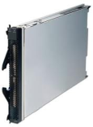
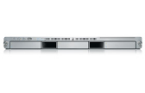
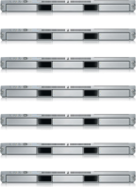


The Matrix From Hell
? | ? | ? | ? | ? | ? | ?
? | ? | ? | ? | ? | ? | ?
? | ? | ? | ? | ? | ? | ?
? | ? | ? | ? | ? | ? | ?
? | ? | ? | ? | ? | ? | ?
? | ? | ? | ? | ? | ? | ?
Static website
Web frontend
Background workers
User DB
Analytics DB
Queue
 | Development VM | QA Server | Single Prod Server | Onsite Cluster | Public Cloud | Contributor’s laptop | Customer Servers
Notes:
Different technologies on different platforms create a “Matrix from Hell”.
Every software component, multiplied by every environment where it has to run at some point
Everything must work.
Code is developed on a laptop, and then shipped to production.
The production server does not run Ubuntu, but CentOS.
It uses a different version of libc and python.
In simple words, it is the challenge of packaging any application, irrespective of language/frameworks/dependencies, so that it can run on any cloud, irrespective of the underlying OS/hardware/infrastructure.

Slide 5
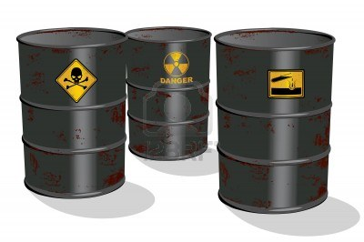

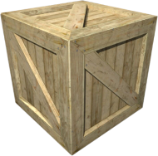
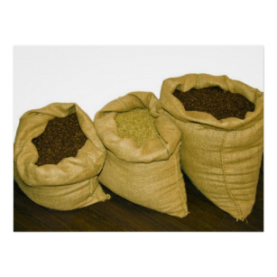
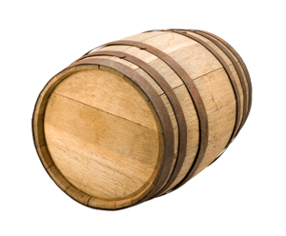
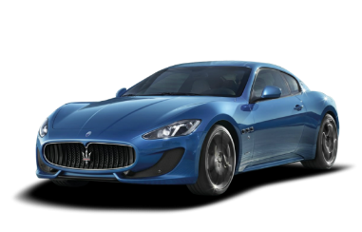
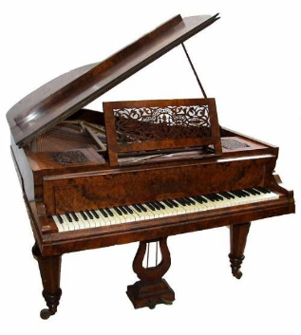



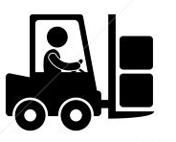
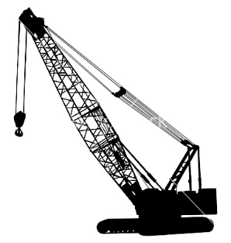
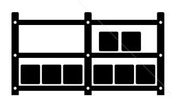

Cargo Transport Pre-1960
Do I worry about how goods interact (e.g. coffee beans next to spices)
Multiplicity of Goods
Multiplicity of methods for transporting/storing
Can I transport quickly and smoothly
(e.g., from boat to train to truck)
Notes:
Look around for a group of people who already had this problem. I need to ship coffee beans, I need to get them to the other side of the world. It is my problem how the goods are handled at every step of the way. Is the staff trained? What truck to use? The type of shipping depends on the type of my goods. Every provider needs an expert in-house who maps out routes and has the knowledge of the means of transports involved. A very fragile and expensive process.

Slide 6
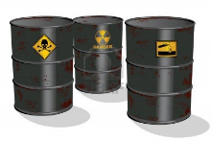

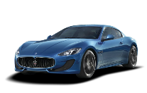


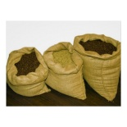


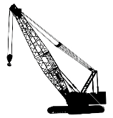



Also a matrix from hell
 | ? | ? | ? | ? | ? | ? | ?
 | ? | ? | ? | ? | ? | ? | ?
 | ? | ? | ? | ? | ? | ? | ?
 | ? | ? | ? | ? | ? | ? | ?
 | ? | ? | ? | ? | ? | ? | ?
 | ? | ? | ? | ? | ? | ? | ?
Notes:
You can present that with the same Matrix of Hell. Every item to ship multiplied by every possible way to ship goods.

Slide 7

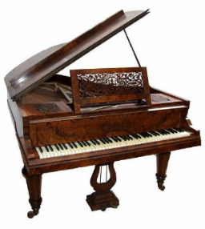

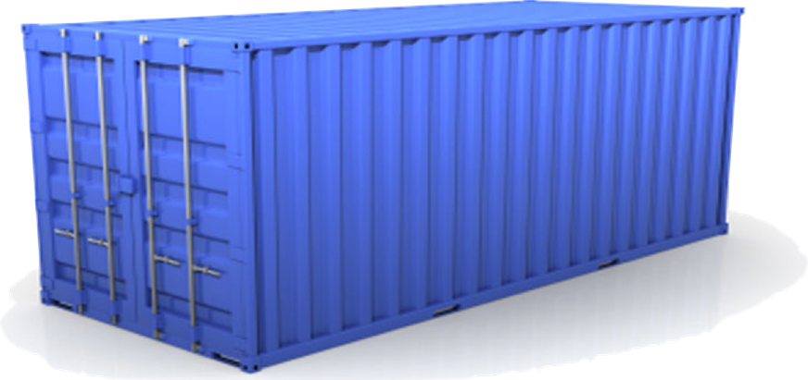
Solution: Intermodal Shipping Container
A standard container that is loaded with virtually any goods, and stays sealed until it reaches final delivery.
…in between, can be loaded and unloaded, stacked, transported efficiently over long distances, and transferred from one mode of transport to another
Notes:
The came up with a solution: a container. They agreed on the size, the weight, how the doors work, where the locks are, where the labels are put and so on. Infrastructure provider standardized on that, as well as people shipping goods.
With this, responsibilities shifted. If I want to ship coffee, I only need to put it into this box and seal it. From that point it is no longer my problem. I can hand it over to a wide variety of infrastructure providers, and even hand it over to a provider that I never dealt with. As an infrastructure provider I can focus on improving: faster boats, bigger truck, better organized facilities.

Slide 8
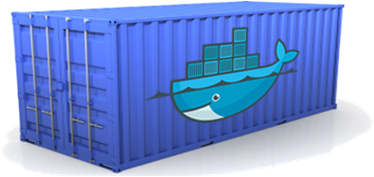
Docker is a shipping container system for code
Static website
User DB
Web frontend
Queue
Analytics DB
An engine that enables any payload to be encapsulated as a lightweight, portable, self-sufficient container…
…that can be manipulated using standard operations and run consistently on virtually any hardware platform
Development VM
QA server
Customer Data Center
Public Cloud
Production Cluster
Contributor’s laptop
Notes:
The same should be applied to software. It is embarrassing that moving software from one data center to another takes longer than shipping good from on side of the planet to the other.
Docker provides a standard way to pack software into a box, with standard properties, and then the box can be handed to other teams or infrastructure providers, and they know how to handle it.

Slide 9
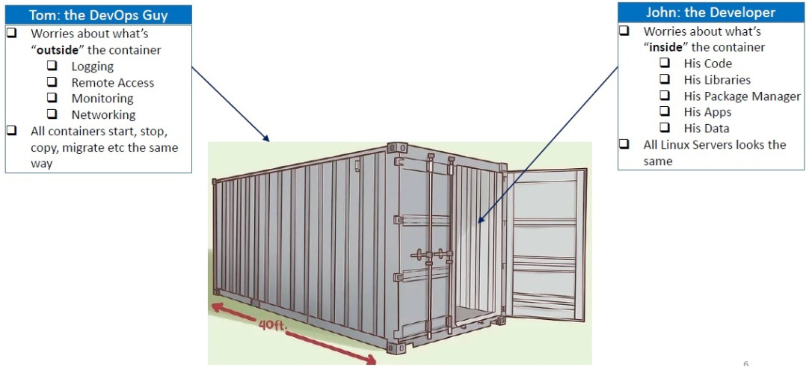
Separation of Concerns
https://crunchytechbytz.wordpress.com/2018/01/23/introduction-to-docker
Notes:
Developers can focus on bundling applications and dependencies as containers, without agonizing over underlying hardware/infrastructure. Administrators/DevOps team can concentrate on managing containers, without agonizing over the contents of those containers. All containers start, stop etc the same way, all Linux servers suddenly look alike.

Slide 10

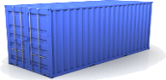
Docker eliminates the matrix from Hell
Static website
Web frontend
Background workers
User DB
Analytics DB
Queue
 | Development VM | QA Server | Single Prod Server | Onsite Cluster | Public Cloud | Contributor’s laptop | Customer Servers
Notes:
Using containers the headache cause by the matrix from hell is suddenly gone.

Slide 11
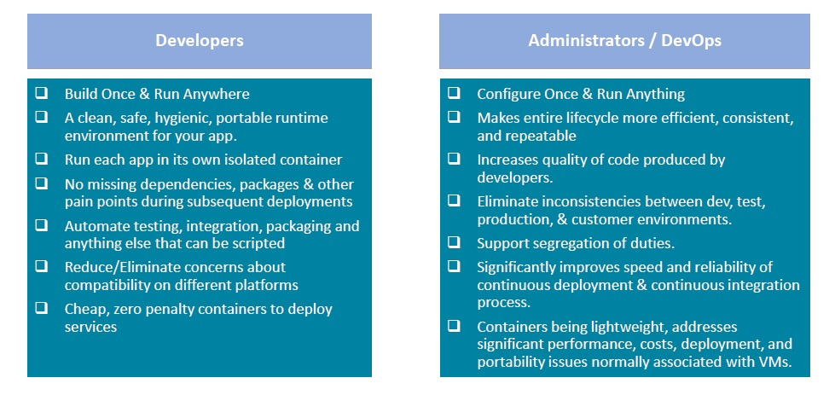
Benefits for Developers & Administrators
https://crunchytechbytz.wordpress.com/2018/01/23/introduction-to-docker
Notes:
Everyone benefits. For developers the long standing promise that Java gave finally came through, build once and run anywhere. As an added bonus, admins only need to configure once and then run everywhere. Apps are isolated, no more hassle with missing dependencies, no inconsistencies, improved speed and reliability etc. Great, isn’t it? This is usually the point where all the issues come up – but not here. It is as great as it sounds. Container do make your life much simpler.

Slide 12
Containerisation How does it work?

Slide 13


The needs of the one vs the needs of the many
VS
Single user
All resources
Multiple user
Limited resources
Data privacy
https://unsplash.com/photos/NuFUbftUu_s
https://images.app.goo.gl/aw1RRCeKKPCpf1yQ7
Notes:
On our laptop or desktop computer, we are the only one using resources. A computer farm usually hosts dozen or hundreds to thousands of users. Resources need to be shared fairly between all users, and great care must be taken to ensure users only have access their data or data to that has been shared with them.

Slide 14

Resources
Processor
Hard drive
Memory
Network
How to separate resources?
Notes:
Clusters are a mix of processors, differing in their speed and the amount of RAM available. Hard drives can be mechanical or solid state. Some areas are backed up, some not. Network connections can have variable speed.
How are all these separations handled?

Slide 15

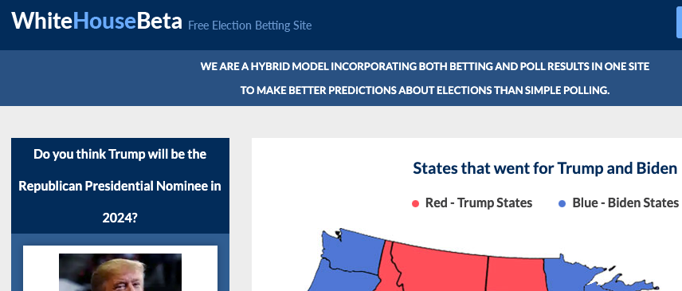
Namespaces!
www.whitehouse.gov
www.whitehouse.com
Notes:
A namespace is a group of related elements that each have a unique name or identifier. There are several different types of namespaces, and each one has a specific syntax used to define the corresponding elements. Each element within a namespace has a "local name" that serves as a unique identifier.
The world wide web is probably the most widely known namespace. Let’s look at at the same element (whitehouse) in two namespaces (gov CLICK and com CLICK).
Though the element is the same, the content is very different.

Slide 16
Kernel Namespaces
Mount
Set of filesystem mounts visible to a process.
Process ID
Provides Process IDs from other namepaces.
Network
Virtualizes network stack. Each network interface (physical or virtual) is present in exactly 1 namespace.
Interprocess Communication
Prevents processes in different IPC namespaces from forming SHM functions.
UNIX Times-Sharing
Allows a system to have different host and domain names for various processes.
User namespace
A user namespace allows a process (that is unprivileged outside the namespace) to have root privileges while at the same time limiting the scope of that privilege to the namespace.
Control group (cgroups)
Limits, accounts for, and isolates the resource usage of a collection of processes.
Time
Allows for per-namespace offsets to the system monotonic and boot-time clocks. Allowing the date/time to be changed within a container, e.g. for adjusting following restoration from a checkpoint/snapshot.
Notes:
Namespaces are a feature of the Linux kernel that partitions kernel resources such that one set of processes sees one set of resources while another set of processes sees a different set of resources.
The feature works by having the same namespace for a set of resources and processes, but those namespaces refer to distinct resources. Resources may exist in multiple spaces. Examples are listed here, one of the most important ones for us is the Control group namespace, it limits, accounts for, and isolates the resource usage of a collection of processes.
The Time Namespace also gets a special mentioning as it has been specifically designed for container support Support Has Been Added to The Linux 5.6 Kernel in March 2020.

Slide 17
Container use namespaces and control groups to create completely isolated environments.
Notes:
That is how the magic works

Slide 18
Container vs Virtual Machine
Notes:
A common question when starting with containers is “What is the difference between a container and a Virtual Machine?”

Slide 19




Operating System
Software
Software
Software
Software
OS Kernel
Hardware
Notes:
Before we go into details, a quick recap on what a operating system is.
An Operating System, is a piece of software that controls the hardware components of a system, be it a phone, laptop or a server.
It oversees the communication between the software and the hardware.
The Kernel is the interface between hardware and software
On top of the Kernel, we have sets of software, and they differ in their type desktops, package managers, compilers etc.

Slide 20
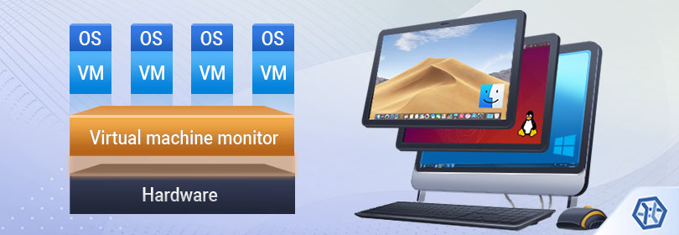
Virtual Machine
https://www.ufsexplorer.com/articles/storage-technologies/virtual-machines-data-organization.php
Notes:
A virtual machine is the virtualization/emulation of a computer system.
Virtual machines are based on computer architectures and provide the functionality of a physical computer.
The virtual machine monitor is called hypervisor; it is computer software, firmware or hardware that creates and runs virtual machines.
Each VM is a full operating system.

Slide 21

Sharing is caring
More details on shared kernel resources
Software
Software
Software
Software
Docker
OS Ubuntu
Kernel
Notes:
Docker differs in a way that it shares as many resources as possible.
Each container only has the additional software that is necessary to run the application inside.
It shares all system libraries with the OS kernel

Slide 22
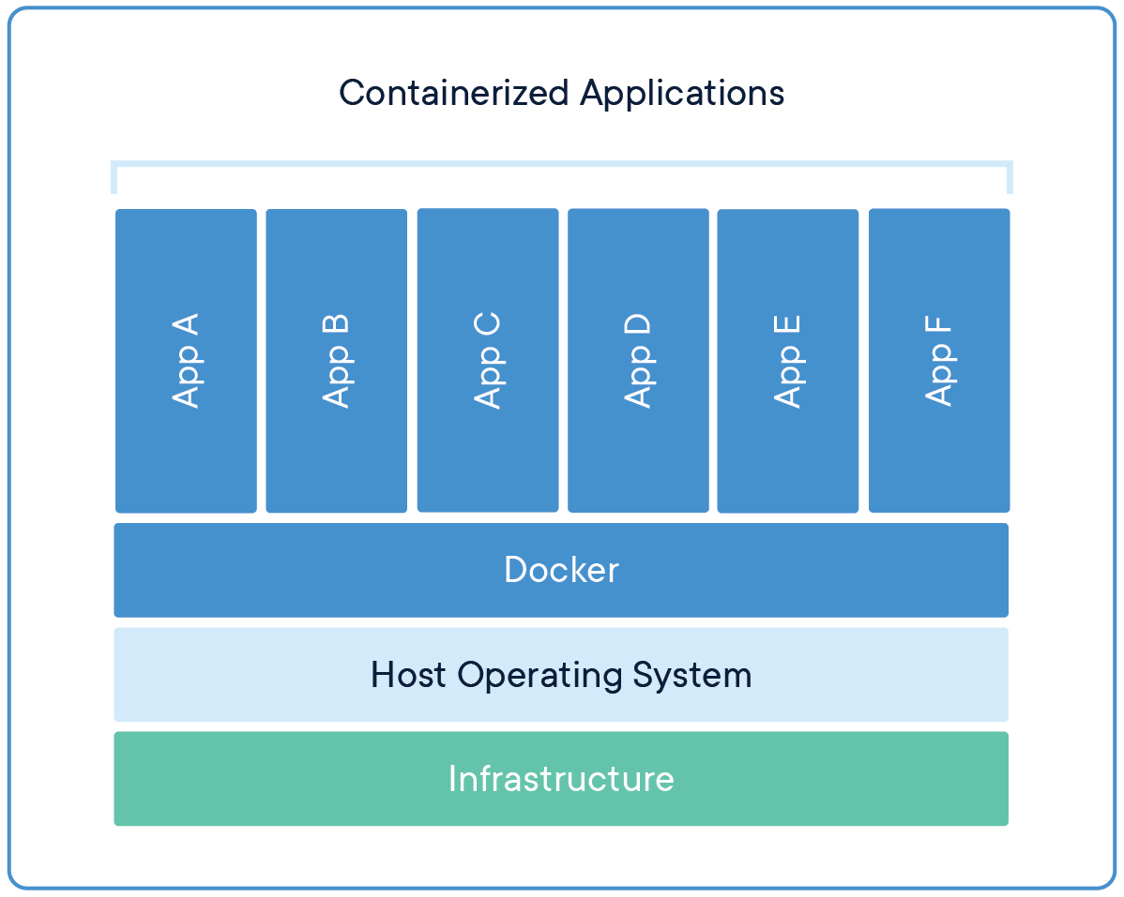
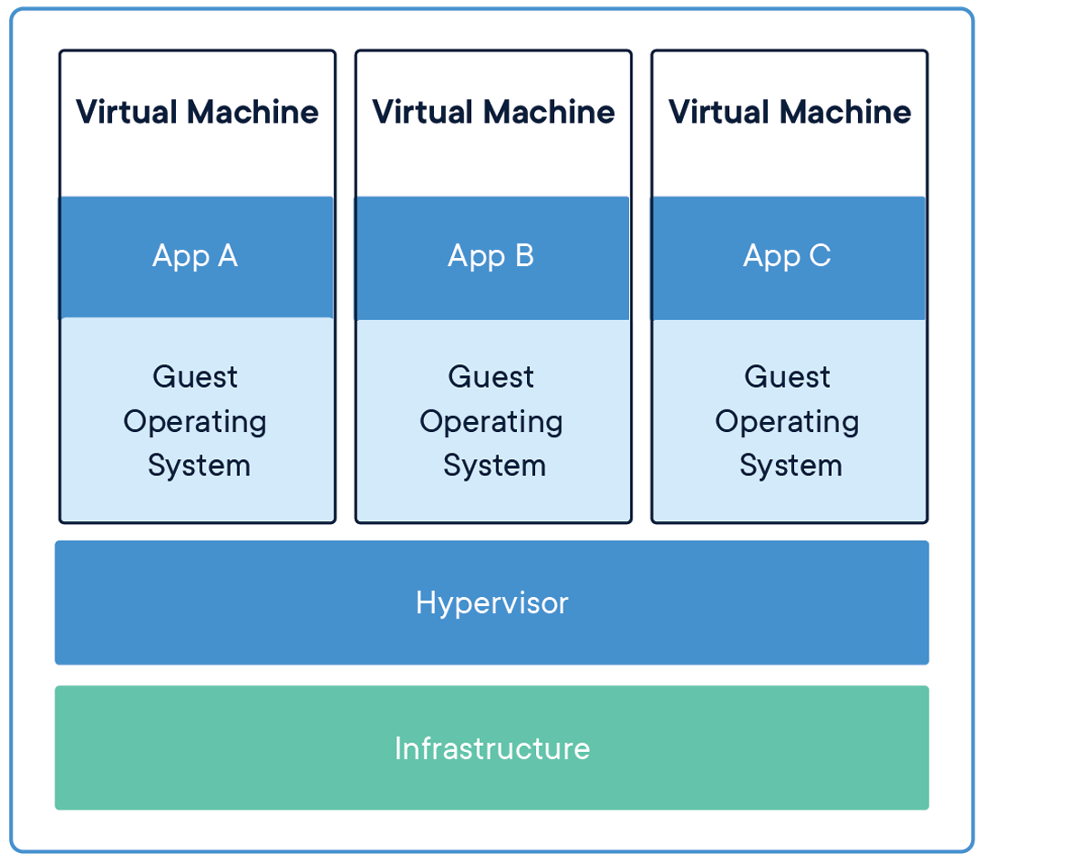
Difference Docker vs Virtual Machine
Notes:
The difference between the two becomes apparent in this overview.
Each Virtual Machine comes with a full operating system, which makes it much slower and more heavy.
But, is it always either or? Of course not!

Slide 23
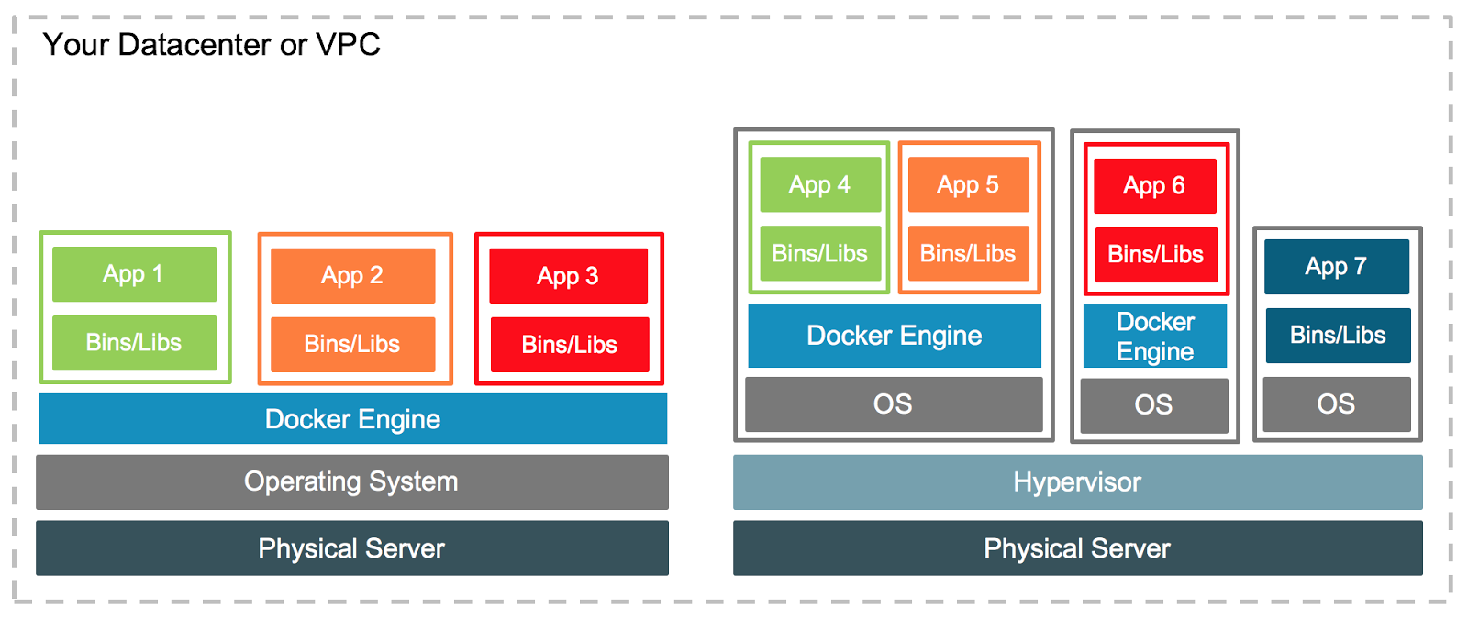
Docker and Virtual Machines
Notes:
Virtual machines and Docker are not exclusive, rather the opposite, they are run together quite often.
Tools like Vmware’s vSphere, a VMware's virtualization platform, transforms data centres into aggregated computing infrastructures, Amazon AWS and Google Cloud platform provide VM’s on demand which then host docker docker engines.
This makes it possible to run mix of VMs, docker container, operating systems, networks etc.
The world is your oyster.

Slide 24
Docker
Notes:
After all this theory, let’s finally get into more practical aspects of Docker

Slide 25
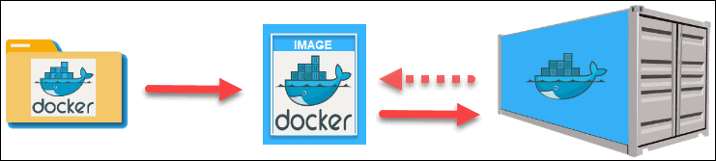

Docker workflow
build
run
Notes:
It all starts with a script of instructions that define how to build a specific Docker image.
This script is called a Dockerfile The file automatically executes the outlined commands and creates a Docker image.
The command for creating an image from a Dockerfile is docker build.
The image is then used as a template or base to run an application.
The application needs an isolated environment in which to run – as discussed earlier, this is a container.
What exactly is a Dockerfile?

Slide 26
Dockerfile
FROM alpine:3.13 AS builder
RUN apk update && \
apk upgrade && \
apk add git ca-certificates
RUN git clone --depth 1 https://github.com/lh3/bwa.git
RUN apk add make gcc libc-dev zlib-dev
WORKDIR /bwa
RUN make
FROM alpine:3.13
COPY --from=builder /bwa/bwa /usr/local/bin
WORKDIR /mnt
ENTRYPOINT ["bwa"]
CMD []
Notes:
A Dockerfile is a text document that contains all the commands a user could call on the command line to assemble an image.
The example above shoes instructions to build an image containing the famous bwa
Docker instructions are written in bold.
Each instruction creates a layer in the image.
Everything necessary to compile bwa is added as instruction
The details of these instructions though is beyond what we can cover in this course.
Next is the image.

Slide 27
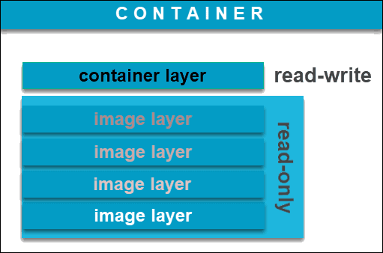
Docker image and container
Notes:
A Docker image is an immutable file that contains the source code, libraries, dependencies, tools, and other files needed for an application to run.
Due to their read-only quality, these images are sometimes referred to as snapshots.
They represent an application and its virtual environment at a specific point in time.
This consistency is one of the great features of Docker.
It allows developers to test software in stable and uniform conditions.
Since images are, in a way, just templates, you cannot start or run them.
What you can do is use that template as a base to build a container. A container is, ultimately, just a running image.
Once you create a container, it adds a writable layer on top of the immutable image, meaning you can now modify it.
Again, the image-base on which you create a container exists separately and cannot be altered.

Slide 28
Commands
Docker [command] --help
Download an image:
docker pull ubuntu
Create a container from an image
docker run -it ubuntu:latest ls -l
#If you dare:
docker run -it ubuntu:latest rm -rf /
#docker run and docker container run are equivalent
Create a container from an image with a name
docker run --name nginx -d nginx
Run a command in a running container
docker exec a24faeb0b374 ls –l
List all images
docker images # docker image ls
List all container
docker container ls
Open a shell in container (debud
docker run -it --rm --entrypoint bash juettemann/genrich
# No BASH use sh
docker run -it --rm --entrypoint sh alpine
Stop a running container
docker kill a24faeb0b374
Kill a running container
docker kill a24faeb0b374
Only use --rm in a test environment!
Notes:
Here we have an overview of commonly used commands.
The structure of the commands should be apparent, it starts with docker followed by a command and options.
The most important one to remember is --help.
It can be added to any command form more information.
The docker run option --rm deserves a special mentioning.
Using it will delete the container once it is finished, which means there won’t be any log to inspect.
Only use it when testing or debugging, but not in a production environment.
I highly recommend to start creating your own cheat sheet.
As you have learned by now, docker is a simple, but complex tool and having a list with commands and notes is really helpful

Slide 29
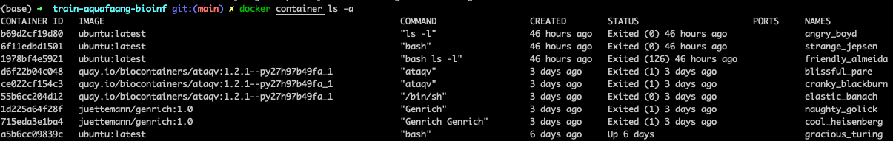
Identifying a docker object
Naming generator: https://github.com/moby/moby/blob/master/pkg/namesgenerator/names-generator.go
Notes:
Another important aspect is how docker identifies objects.
An object can be a container, an image, a network etc.
All objects are identified by an universally unique identifier (UUID), which is a 128-bit label.
When interacting with Docker you can either use the whole string (next slide), or the short version displayed with the ls command.
In fact, you only need to type as many character as necessary to have a unique string.
Container also have a name.
This name can either be assigned by you, or it is automatically generated from a list of adjectives and famous scientists or hackers.
That is list can be extended!

Slide 30
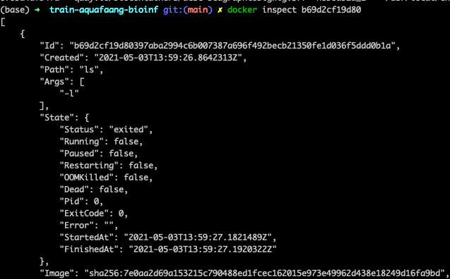
Inspecting a container
Notes:
We can find more information about a docker object by inspecting its UUID (short or long).
This can give you valuable information

Slide 31


Image sources
World’s largest repository of container images (5.5m, 13b DL/month)
Teams & Organizations
Manage access to private repositories of container images.
Official Images
Pull and use high-quality container images provided by Docker.
Publisher Images
Pull and use high- quality container images provided by external vendors.
Builds
Automatically build container images from GitHub and Bitbucket and push them to Docker Hub.
Webhooks
Trigger actions after a successful push to a repository to integrate Docker Hub with other services.
https://hub.docker.com/
Community-driven project
Specialised in bioinformatics tools
Provides the infrastructure and basic guidelines to create, manage and distribute bioinformatics packages (e.g conda) and images (e.g docker, singularity)
Provide guidelines and help on how to create reproducible pipelines and workflows using bioinformatics containers.
Users are able to request an image to be created.
https://biocontainers.pro/
https://academic.oup.com/bioinformatics/article/33/16/2580/3096437

Slide 32

Singularity
The “Singularity Launcher” is run by the user, loads the Singularity container and executes applications as the user.
No need to virtualize everything,
No direct means to obtain root/superuser within the container
”If you want to be root inside of the container, you must first be root outside of the container”
https://sylabs.io/

Slide 33
Singularity vs Docker
Docker needs a daemon running in every node in a cluster (maintenance overhead). Singularity is only a binary which can be executed directly by any user.
Docker daemon is owned by root, sys admins need to isolate network namespace, create an accounting mechanism for resource usage, create a mechanism to let docker write in shared file systems Singularity runs as the user, using all their permissions/restrictions
Singularity is compatible with Docker
Singularity community is much smaller

Slide 34
Cmd
Entrypoint (Genrich)
WorkingDir
Run Docker as user, not root. Or change dir
Container naming
Container ID. Mention that
Pass env vars
Versions of images
Base images
-e TERM=xterm http://www.mimastech.com/2017/01/08/how-to-setfix-the-term-environment-variable-in-docker/

Slide 35
None image
The Good <none>:<none>
These are intermediate images and can be seen using docker images -a. They don't result into a disk space problem, but they take space on the screen
The Bad <none>:<none>
These images are the dangling ones, which can cause disk space problems. These <none>:<none> images are being listed as part of docker images and need to be pruned: docker image prune
(a dangling file system layer in Docker is something that is unused and is not being referenced by any images. Hence we need a mechanism for Docker to clear these dangling images)

Slide 36
Overview
Term | Description
Dockerfile | text document that contains all the commands a user could call on the command line to assemble an image.
Layer | Set of read-only files to provision the system. Think of a layer as a read only snapshot of the filesystem.
Image | Read-only layer that is the base of your container. It can have a parent image to abstract away the more basic filesystem snapshot. A Java image would inherit from a linux image with the preinstalled utilities. A tomcat image will have a Java image as the parent because it depends on Java to run Tomcat.
Container | Runnable & writeable instance of the image. Basically it is a process isolated by docker that runs on top of the filesystem that an image provides.
Registry / Hub | Central place where all publicly published images live. You can search it, upload your images there and when you pull a docker image, it comes the repository/hub.
Docker machine | VM within which you can run Docker containers. On Linux you can run docker containers natively, but on OSX and Windows you need a layer of abstraction. A docker machine will spin a very lightweight virtual machine that integrates with the docker command line utilities really well.

Slide 37
docker –help
docker run --help

Slide 38
Exercises

Slide 39
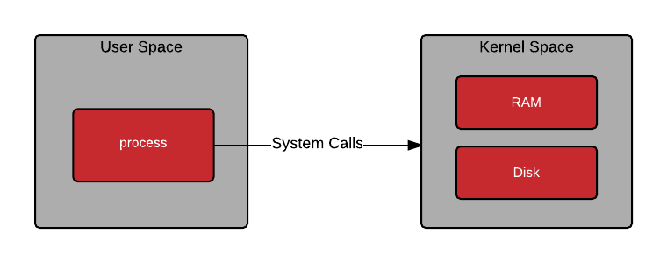
Traditional
Notes:
Kernel space has full access to all the systems resources.
User space inter

Slide 40
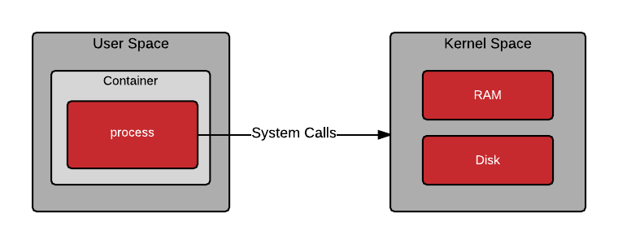
Container

Slide 41
Namespaces
Open an interactive bash shell using

Slide 42
Terminal 1
docker run -t -i --rm --privileged ubuntu:latest bash
unshare -m /bin/bash
secret_dir=`mktemp -d --tmpdir=/tmp`
echo $secret_dir
# tmp.4Jsgc4LsGh
mount -n -o size=1m -t tmpfs tmpfs $secret_dir
df –hT #shortened output
# tmpfs tmpfs 1.0M 0 1.0M 0% /tmp/tmp.hxtTL4l86R
cd $secret_dir
touch file1 file2
ls –l
Terminal 2
docker container ls –a
# CONTAINER ID IMAGE COMMAND CREATED STATUS PORTS NAMES
# e13395437ff4 ubuntu:latest "bash" 26 minutes ago Up 26 minutes distracted_
export container_id='<put CONTAINER ID here>' #in this case: export container_id='e13395437ff4'
docker exec -t -i --privileged $container_id bash
ls -l /tmp
# total 4
# drwx------ 2 root root 4096 Mar 15 04:02 tmp.4Jsgc4LsGh
cd /tmp/tmp.4Jsgc4LsGh/
ls –l
# total 8
# drwx------ 2 root root 4096 Mar 15 04:02 ./
# drwxrwxrwt 1 root root 4096 Mar 15 04:02 ../

